Slide 1
Online Event Organizer
Presented By:
Mosarrat Shazia Kabir(1831228642)
Syeda Karishma Naaz (1831270642)

Slide 2
Online Event Organizer
A web based organization which will help the users to find their suitable event plans, wedding plans, booking convention halls, photographers and catering services.

Slide 3
Motivation
Reduce time consumption.
Hassle to find proper plans.
Help in pandemic situation.

Slide 4
Features
Categories
Each services(Events) are categorized so that users can find their expected service easily.
Services
Users can find various services or event plans.
Appointment
For appointment or booking an user needs to fill a simple form.

Slide 5
Features
Reviews
Users can write their valuable reviews and upload photos.
Cancel Appointment
Users can cancel appointment with an ensuring message.
Contacts
Users can see the admin details.

Slide 6
Features
Admin Login and change password
The admins have to login to see the details.
Editing
Admins can edit the categories/services image, price, descriptions, status etc.
Appointments
Admins can change the status of any appointment.
An admin can change his/her password.

Slide 7
Technology
Front-end design:
HTML & CSS
Framework:
Bootstrap
Database:
MySQL server
Programming Language:
PHP programming language
Development Environment:
XAMPP server

Slide 8
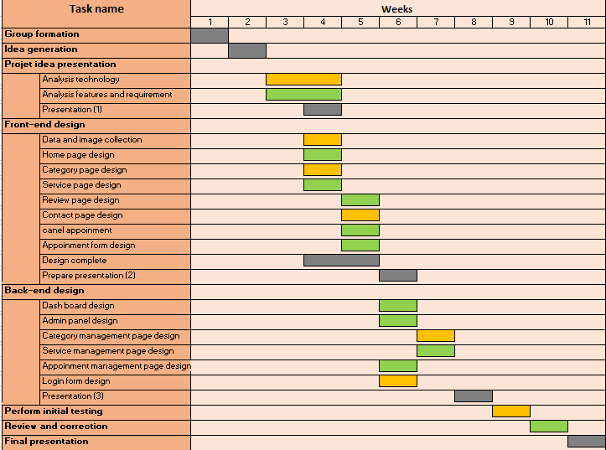

Timeline (Gannt chart)

Slide 9
Thank You For Your Attention
Any Question?

